Slide 1


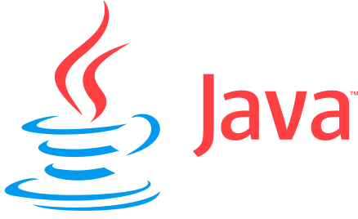
ITI1121A
LAB #3
Friday 11:30 – 14:30
Professor: Nour El-Kadri
TA: Berk Soysal
bsoys096@uottawa.ca
Office Hour: Fridays 15:00 – 16:00
Office Location: SITE 5000D
Download this ppt. - http://uottawa.ml
2016 Winter Prepared by Berk Soysal for ITI1121A

Slide 2
‘==‘ and equals()
The operator ”==” is used to compare two objects regarding their references.
This means, the operator checks whether or not these two objects refer to the same place in memory.
For example;
String s1 = new String("xyz");
String s2 = new String("xyz");
if(s1 == s2)
System.out.println(“s1==s2 is TRUE");
else
System.out.println(“s1==s2 is FALSE");
What would be the output ?
http://uottawa.ml → Lab3 →Lab3 Examples →Equality.java
2016 Winter

Slide 3
‘==‘ Operator
Note 1: Every time we create a new object, the object gets its own unique address in the memory.
Note 2: This type of comparison is called reference comparison.
2016 Winter
Download this ppt. - http://uottawa.ml

Slide 4
equals()
The intent of the equals method is to compare whether two objects are semantically the same, if they have the same content.
For classes from the Java library (Wrappers, Strings etc.), this is indeed what will happen.
For your own class however, you have to provide your own implementation of equals. For example;
String s1 = new String("xyz"); String s2 = new String("xyz"); if(s1.equals(s2)) System.out.println(“s1 equals s2 is TRUE"); else System.out.println(“s1 equals s2 is FALSE");
What would be the output ?
http://uottawa.ml → Lab3 →Lab3 Examples →Equality.java
2016 Winter

Slide 5
Why Documentation is Important ?
Documentation
Another important aspect of software development is the documentation.
JavaDoc is a format for your Java comments, and a set of tools for producing Web pages automatically.
In ITI1121, we are asking you to document your code (variables, methods, etc.) using JavaDoc.
2016 Winter
Download this ppt. - http://uottawa.ml

Slide 6
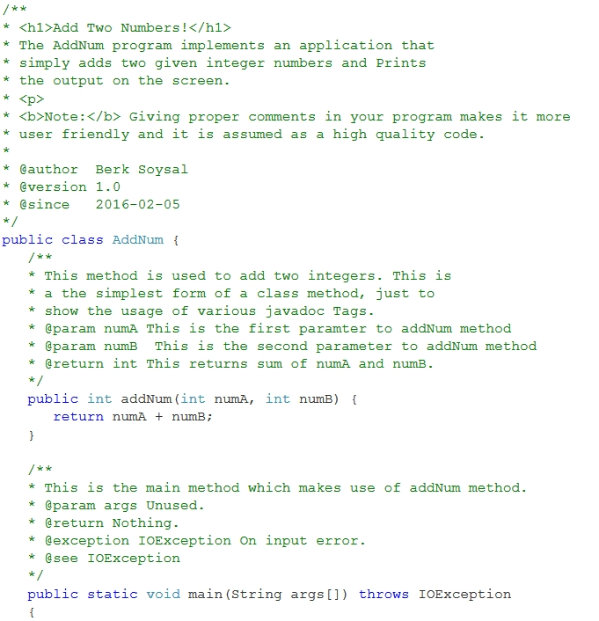
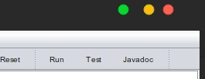
Click here after you finish writing the code + documentation
2016 Winter
Download this ppt. - http://uottawa.ml

Slide 7
Array Manipulations findAndReplace()
Let’s complete the implementation of the (static) class method String[] findAndReplace(String[] in, String[] what, String[] with) of the class Utils.
The method returns a copy of the array in where each word occurring in the array what has been replaced by the word occurring at the corresponding position in the array with.
The array designated by in must remain unchanged.
2016 Winter
Download this ppt. - http://uottawa.ml

Slide 8
JUnit Testing
JUnit is a simple framework to write repeatable tests. It is an instance of the xUnit architecture for unit testing frameworks.
A set of test cases is written
to test a method’s operation.
We use various methods of the
Assert Class to test our
findAndReplace() method.
Only the failed assertions are recorded.
Click here to test your method
2016 Winter
Download this ppt. - http://uottawa.ml

Slide 9
More on Objects!
Let us implement a class to represent rational numbers..
Each rational number consists of a numerator and a denominator, both of type int. Since each rational number has its own numerator and denominator, these must be instance variables.
Create 2 constructor methods as instructed in the lab script.
2016 Winter
Download this ppt. - http://uottawa.ml

Slide 10
Setters and Getters
The public setXYZ () and getXYZ() methods are the access points of the instance variables of a class.
Normally, these methods are referred as getters and setters.
Therefore any class that wants to access the variables should access them through these getters and setters.
An object that has no setter methods, and no other methods for transforming the state of the object, is said to be immutable.
2016 Winter
Download this ppt. - http://uottawa.ml

Slide 11
Immutable Objects
An object is considered immutable if its state cannot change after it is constructed. Maximum reliance on immutable objects is widely accepted as a sound strategy for creating simple, reliable code.
Since they cannot change state, they cannot be corrupted by thread interference or observed in an inconsistent state.
2016 Winter
Download this ppt. - http://uottawa.ml

Slide 12
Class Methods vs. Instance Methods
Sometimes, you want to have variables that are common to all objects. This is accomplished with the static modifier. Fields that have the static modifier in their declaration are called class methods.
When a number of objects are created from the same class blueprint, they each have their own distinct copies of instance methods.
2016 Winter
Download this ppt. - http://uottawa.ml

Slide 13
Static versus Non-Static Methods
You can do this to execute a static method:
MyClass.staticMethod();
//Simply refers to the class's static code
But to execute a non-static method, you must do this:
//Create an instance
MyClass obj = new MyClass();
//Refer to the instance's class's code
obj.nonstaticMethod();
2016 Winter
Download this ppt. - http://uottawa.ml

Slide 14
Write Documentation for “Rational” Class
Documentation Exercise !
Add JavaDoc comments for the class Rational. 1. Add JavaDoc comments for all the methods. Each comment should include a brief description of what the method does and descriptions of the parameters and the return value using JavaDoc format.
2. Add a brief description of the class Rational, using the JavaDoc syntax, make sure to include the name of the author of the class (you).
2016 Winter
Download this ppt. - http://uottawa.ml

Slide 15
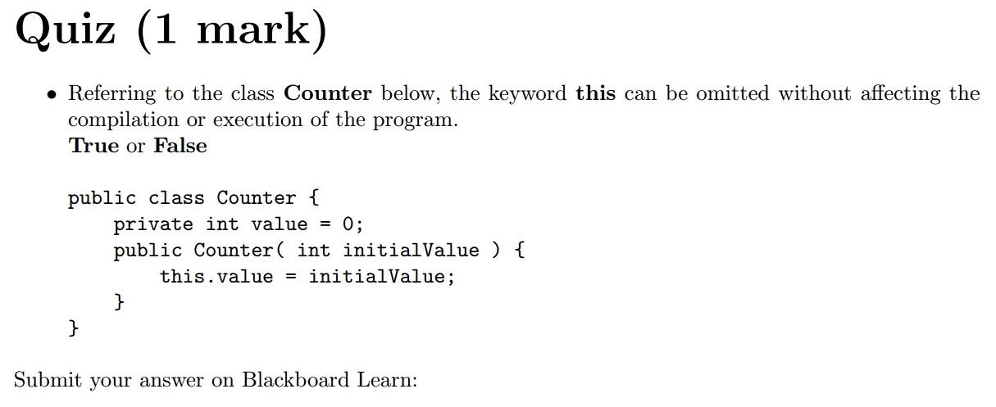
Submit Your Quiz Answer, Codes & Documentations in a single submission to BlackBoard
Quiz Question and Submission
2016 Winter
Download this ppt. - http://uottawa.ml

